Slide 1
HTTPS API
Colby Roberts

Slide 2
01
Basics

Slide 3
https://www.loremispum.com/
Notes:
Some of you may be familiar with this but this is a website URL

Slide 4
https://www.loremispum.com/api/v2/
Notes:
By adding a route to the URL, I’m able to request data from the website. The part of the route in red is commonly used to denote if the request is for an API call and what version of the API to use.

Slide 5
GET
https://www.loremispum.com/api/v2/get-user-by-id/:id
Notes:
An example GET Request can be seen here, the specific data requests is some user information, and the “colon id” is where the request specifies the user they want information on.

Slide 6
POST
https://www.loremispum.com/api/v2/post-user
body: {
'username': 'lorem',
'password': 'ispum',
'dolor': 'sit',
'consectetur': 'adipiscing elit'
}
Notes:
Switching over to a POST request, which for the sake of an example requires more security, validation, and verification, than a GET request. This new request is trying to create a new user, and in the body you can see what the request wants to input for this new user’s information.

Slide 7
POST
https://www.loremispum.com/api/v2/post-user
body: {
'username': 'lorem',
'password': 'ispum',
'dolor': 'sit',
'consectetur': 'adipiscing elit'
},
headers: {
'Accept': 'application/json',
'Content-Type': 'application/json',
Notes:
Next I’ll describe some common headers. The ‘Accept’ header is what this new POST request is willing to get as a return for itself to process. Conversely ‘Content-Type’ header is telling the server what type the body will be for it to process.

Slide 8
02
Header (Client-side) Security
Notes:
Starting off on the my security features, the header or client sided security.

Slide 9
POST
https://www.loremispum.com/api/v2/post-user
body: {
'username': 'lorem',
'password': 'ispum',
'dolor': 'sit',
'consectetur': 'adipiscing elit'
},
headers: {
'Accept': 'application/json',
'Content-Type': 'application/json',
Notes:
Now back to this POST request example, let’s add the first and one of the most powerful security features HTTPS offers, the ‘Strict-Transport-Security' header.

Slide 10
POST
https://www.loremispum.com/api/v2/post-user
body: {
'username': 'lorem',
'password': 'ispum',
'dolor': 'sit',
'consectetur': 'adipiscing elit'
},
headers: {
'Accept': 'application/json',
'Content-Type': 'application/json',
'Strict-Transport-Security': 'max-age=31536000',
Notes:
The ‘Strict-Transport-Security’ header is used to instruct web browsers to only interact with a website over HTTPS, enhancing security by preventing man-in-the-middle attacks and protocol downgrade attacks. It is a response header that specifies a period during which the user agent should only access the service via HTTPS requests. The common default values I found was a 365 days or 315 million seconds.

Slide 11
POST
https://www.loremispum.com/api/v2/post-user
body: {
'username': 'lorem',
'password': 'ispum',
'dolor': 'sit',
'consectetur': 'adipiscing elit'
},
headers: {
'Accept': 'application/json',
'Content-Type': 'application/json',
'Strict-Transport-Security': 'max-age=31536000',
'Public-API-Key': publicKey,
Notes:
Next I add the second layer of defense, a public API key. You’re all familiar with it so I won’t dive into it, it’s obvious how it works.

Slide 12
const contentMD5 = CryptoJS.MD5(body).toString(CryptoJS.enc.Hex);
Notes:
Next I create the third layer of defense a signature, first I start off with creating a MD5 encryption of the body, which holds information about the new user in this API Post request example.

Slide 13
const contentMD5 = CryptoJS.MD5(body).toString(CryptoJS.enc.Hex);
function generateSignature(secretKey, verb, contentMD5, contentType, timestamp, requestURI, nonce) {
const StringToSign = verb + '\n'
+ contentMD5 + '\n'
+ contentType + '\n'
+ timestamp + '\n'
+ requestURI + '\n'
+ nonce;
const signature = CryptoJS.HmacSHA256(StringToSign, secretKey).toString(CryptoJS.enc.Base64);
return signature;
}
Notes:
And I use the function above to generate a signature for the server to verify the integrity of the data. Going through the arguments, the secret key is obvious, the verb is the type of request, GET, POST, PUT, DELETE, etc, in this example it will be “POST.” The “contentMD5” argument is the encrypted body. The timestamp is when the request was initialized by the client so I don’t get any reply attacks. The “requestURI” is the full route used, from “https” to “slash post user.” Finally the nonce, “number only used once” to add some confusion to the 256 bit encryption.

Slide 14
POST
https://www.loremispum.com/api/v2/post-user
body: {
'username': 'lorem',
'password': 'ispum',
'dolor': 'sit',
'consectetur': 'adipiscing elit'
},
headers: {
'Accept': 'application/json',
'Content-Type': 'application/json',
'Strict-Transport-Security': 'max-age=31536000',
'Public-API-Key': publicKey,
Notes:
So the new headers will be appended like so,

Slide 15
POST
https://www.loremispum.com/api/v2/post-user
body: {
'username': 'lorem',
'password': 'ispum',
'dolor': 'sit',
'consectetur': 'adipiscing elit'
},
headers: {
'Accept': 'application/json',
'Content-Type': 'application/json',
'Strict-Transport-Security': 'max-age=31536000',
'Public-API-Key': publicKey,
'Authorization': `TXC-HMAC-SHA256${publicKey}:${signature}`,
'X-TXC-Nonce': nonce,
'X-TXC-Timestamp': timestamp
}
Notes:
The colors are not necessary of course.

Slide 16
03
CORS Policy
Notes:
Next I have to worry about HTTPS preventing cross origin requests, which is perfectly fine for an internal API, but I’m making a public API.

Slide 17
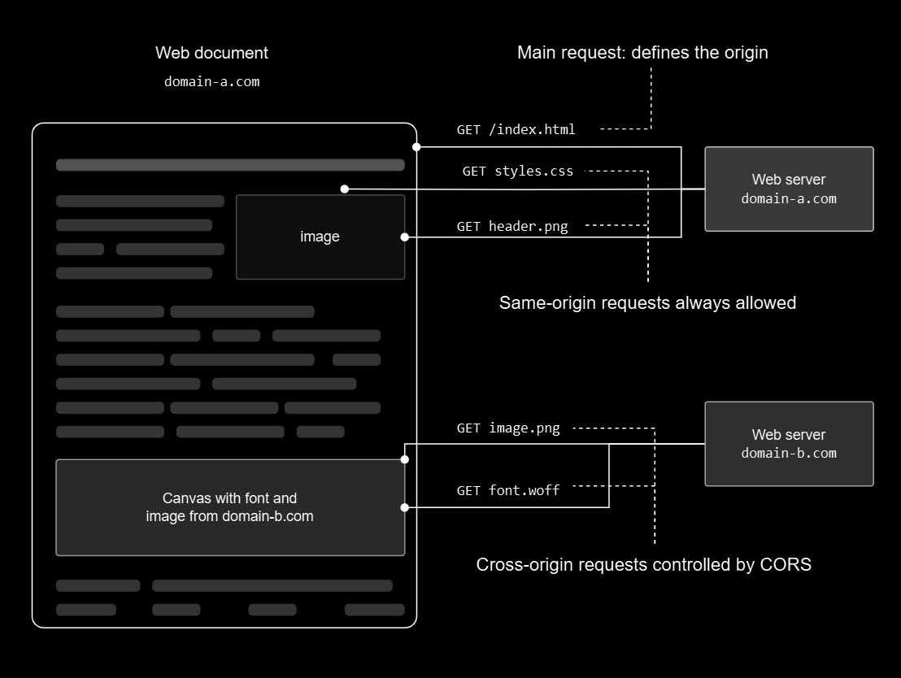
Notes:
The broader CORS policy is fairly simple. Looking at the totally officially licensed image from Mozilla, you can see what is and isn’t handled by CORS. Now since I’m opening my API to the world I need to worry about malicious and nefarious actors.

Slide 18
04
Server-side Security
Notes:
So we move onto server-side security.

Slide 19
async validatePublicKey(publicKey) {
const validPublicKey = this.validateStr('publicKey', publicKey);
if (!validPublicKey.valid) {
return validPublicKey;
}
const splitPublicKey = publicKey.split('_');
const splitPublicKeyLengths = splitPublicKey.map(e => e.length);
const parameter = new APIParameter();
if (publicKey.length != 42 || splitPublicKey.length != 3 || !parameter.areArraysEqual(splitPublicKeyLengths, [2, 4, 34])) {
return { valid: false, error: { code: 406, message: `Invalid public key.` } }
}
const customer = await CustomerService.validatePublicKey(publicKey);
if (customer) {
return { customerId: customer.id, valid: true, error: null };
}
return {
valid: false,
error: { code: 404, message: `Customer not found.` }
};
}
Notes:
I first validate the public key from the example, where I validate the type, check the structure of the proposed key is my key structure, and then make sure the key is someone’s key. Pretty basic.

Slide 20
async authenticateSignature(req) {
const publicKey = req.header("Public-API-Key");
const validator = new APIValidator();
const customer = await validator.validatePublicKey(publicKey);
if (customer.valid) {
const secretKey = await CustomerService.getSecretKey(customer.customerId, publicKey);
const verb = req.method;
const body = req.body;
const contentType = req.header("Content-Type");
const timestamp = req.header("X-TXC-Timestamp");
const requestURI = req.url;
const nonce = req.header("X-TXC-Nonce");
const authorizationHeader = req.header("Authorization");
const clientSignature = authorizationHeader.split(' ')[1].split(":")[1];
const expectedSignature = this.generateSignature(secretKey, verb, body, contentType, requestURI, timestamp, nonce);
if (clientSignature === expectedSignature) {
return this.authenticatedReturn;
} else {
return this.notAuthenticatedReturn;
}
} else {
return customer.error;
}
}
Notes:
Next I authenticate the signature the client generated, using the same function from earlier, I grab all the information from the body and headers and generate a signature to verify that integrity of the data received on the server is ensured.

Slide 21
inspectRequest(apiKey, statusCode) {
const now = Date.now();
const isUnauthorized = statusCode === 401;
const record = this.apiKeyStore.get(apiKey) || { timestamps: [], blockedUntil: null };
if (record.blockedUntil && now < record.blockedUntil) {
return { anomalous: true, reason: 'API key temporarily blocked' };
}
if (record.blockedUntil && now >= record.blockedUntil) {
record.blockedUntil = null;
}
if (isUnauthorized) {
record.timestamps.push(now);
record.timestamps = record.timestamps.filter( timestamp => now - timestamp <= this.config.timeWindow );
if (record.timestamps.length >= this.config.threshold) {
record.blockedUntil = now + this.config.cooldownPeriod;
this.apiKeyStore.set(apiKey, record);
return { anomalous: true, reason: `Exceeded unauthorized attempts (${record.timestamps.length}/${this.config.threshold})` };
}
}
this.apiKeyStore.set(apiKey, record);
return { anomalous: false };
}
Notes:
Next I run an additional process where I inspect the request. This code above is a shortened version of the real thing, but this abridged function is for rate limiting, checking when the api key was last used and if it should be limited.

Slide 22
const schema = {
user: {
isObject: {
errorMessage: "Invalid type for user",
bail: true
},
notEmpty: {
errorMessage: "Must enter student data",
bail: true
}
},
"user.username": {
isString: {
errorMessage: "Invalid value for username",
bail: true
},
custom: {
options: parameter.isStr.bind(parameter),
bail: true
},
},
}
const { checkSchema } = require('express-validator');
validateBody(req, res, next, schema) {
let result = checkSchema(schema);
result[result.length - 1](req, res, next);
}
class APIParameter {
constructor() { }
isInteger(str) {
return !isNaN(str) &&
Number.isInteger(parseFloat(str));
}
isStr(str) {
return typeof str === 'string' &&
!this.isInteger(str);
}
}
Notes:
Suppose the request is clean and everything before this step has been authenticated, and verified. Next I check the structure of the body, using express validator’s “checkSchema,” One can define a schema the body must follow for the parameters to be validated.

Slide 23
async sendResponse(res, json, code = 200) {
res.setHeader('Access-Control-Allow-Credentials', 'omit');
res.setHeader('Access-Control-Allow-Origin', '*');
res.status(code).send(json);
}
Notes:
Consider that the checkSchema gave the green light, so the server goes ahead and processes the request. Next I have to worry about CORS policy. It by default blocks cross origin request, so by adding the headers above to the response, I tell the server allow CORS to send a response back. This 7 step process is my HTTPS API security.

Slide 24
05
Problem with existing approaches
Notes:
Next I will dog on my competitors,

Slide 25
Problem with existing approaches
01
COMPLEX
04
INCONSISTENCIES
Steep Learning Curve
Extensive Configuration
Continuous Maintenance
Integration Challenges
Diverse Standards
Evolving Threats
Inadequate Documentation
Fragmented Tooling
Variable Compliance
02
COSTLY
05
OTHER VULNERABILITIES
High Licensing Fees
Integration Expenses
Incident Remediation
Backdoors
Zero Day Threats
03
NO ANOMALY DETECTION
Focus on Known Threats
Performance Concerns
Resource Limitations
False Positives
Implementation Complexity
Notes:
The problem with existing approaches is that they’re often complex, engineers nowadays often don’t know how to use these secure API because they’re not taught how to use them. This increases costs, on top of the high licensing fees of the API’s. On top of this popular API’s don't have anomaly detections, deciding to focus on known threats due to the false positive rate. This increases internal complexity and raises performance concerns. They’re also incredibly inconsistent with one another, having diverse standards and inadequate documentation for some poor engineers to suffer through. There's also other vulnerabilities which vary from company to company, the diverse standards issue.

Slide 26
06
Solution
Notes:
Now my solution,

Slide 27
Solution
01
HTTPS
04
SECURE KEYS
Data Encryption
Server Authentication
Data Integrity
User Trust
Access Control
Usage Monitoring
Service Monetization
Enhanced Security
02
256 BIT ENCRYPTION
05
RATE LIMITING
Strong Security
Quantum Resistance
Future Proofing
Prevents Abuse
Ensures Fair Usage
Mitigates DDoS Attacks
03
INPUT VALIDATION
06
ANOMALY DETECTION
Prevents SQL Injection
Mitigates XSS Attacks
Ensures Data Integrity
Zero-Day Threat Identification
Early Warning System
Adaptive Security
Notes:
I’m using HTTPS which on it’s own is very secure in it’s own right but malicious and nefarious actors could datamine my client side apps and get access to endpoints I might not want them to make. So I use a 256 bit encryption which is so strong its difficult for modern quantum computers to crack, except the new one microsoft just made like 3 weeks ago. I also validate the parameters and inputs for data integrity which prevents input attacks like SQL injections and XSS attacks. I use secure 34 character keys which allows for plentiful keys for my 100% real extensive user base. Now to prevent bandwidth issues for my user’s I implemented rate limiting for fair usage and mitigate DDoS attacks and other rate abuse methods. Finally I also created an anomaly detections class for zero-day threats and adaptive security.

Slide 28
07
Demo
Notes:
Now I could show you the demo but it’s just running a script that gives me a thumbs up on if the requests have the expected return or not. I personally wouldn’t wanna see a script thinking for a bit going over several good and intentionally bad requests. So raise your hands if you want to see it? No? Ok next slide.

Slide 29
08
Questions?
Notes:
Any questions?
A Cross-Site Scripting (XSS) attack is a type of injection attack where an attacker injects malicious code into a trusted website, which is then executed by the victim's browser when they visit the site. A type of man in the middle attack.

Slide 30
THANK YOU
Colby Roberts

